Slide 1
Mitigating Bird Strikes in Aviation
NAME : Hridhthik
MENTOR : Jaya Pandey

Slide 2
INTRODUCTION:
Bird strikes pose a significant threat to aviation safety, causing aircraft damage, flight disruptions, and, in some cases, tragic loss of life.
As air traffic continues to grow, so does the risk of these incidents.
To mitigate this risk, it is crucial to understand the patterns and factors contributing to bird strikes.
This project aims to analyze historical bird strike data to identify trends, hotspots, and potential mitigation strategies.
By gaining insights into bird strike occurrences, we can develop effective measures to protect aircraft and ensure safe flight operations.

Slide 3
OBJECTIVE:
Identify Trends: Analyze historical data to identify patterns in bird strike occurrences.
Identify Risk Factors: Determine factors contributing to bird strikes, such as bird species, weather, and airport location.
Develop Predictive Models: Create models to forecast potential bird strike hotspots and high-risk periods.
Inform Decision-Making: Provide actionable insights to improve bird strike prevention and response.

Slide 4
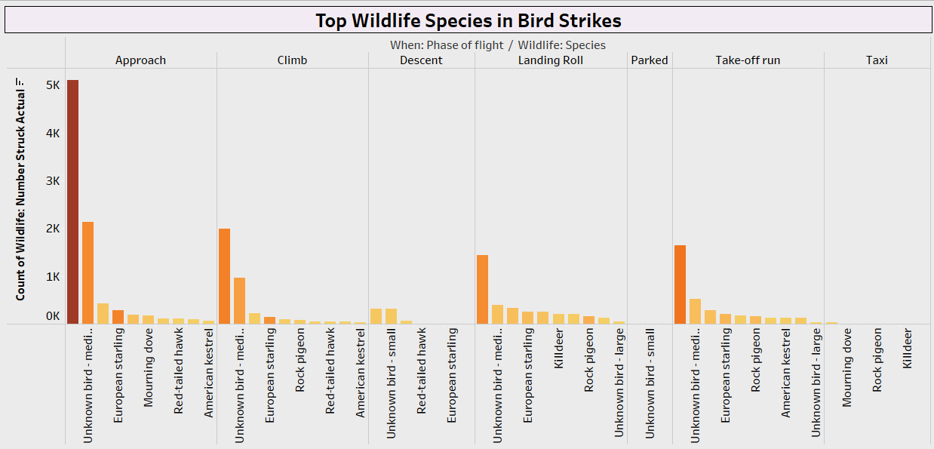
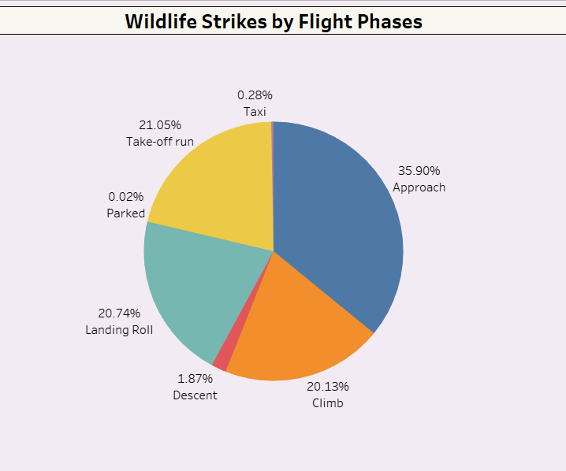
The most common wildlife species involved in bird strikes
Which phase of flight are wildlife strikes most likely to occur?
The Unknown Bird Medium is one of the wildlife species that gets struck in aircraft most frequently.
During Approach phase of flight are wildlife strikes most likely to occur.

Slide 5
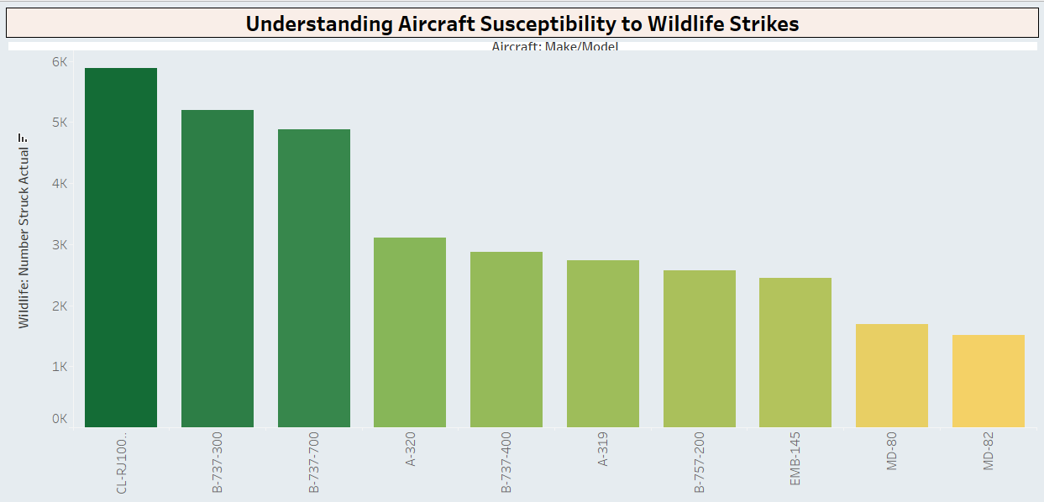
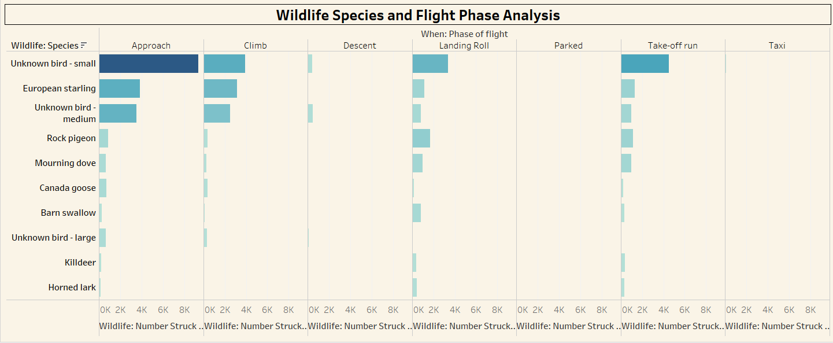
Specific aircraft models or types that are more prone to wildlife strikes
The most common wildlife species involved in bird strikes, and when do they occur
The Approach phase and Take-off run are the most critical times for bird strikes, Unknown bird - small species account for the largest proportion of bird strikes across all phases of flight.
Specific aircraft model or type that are more prone to wildlife strikes is CL-RJ100/200 followed by
B-737-300.

Slide 6
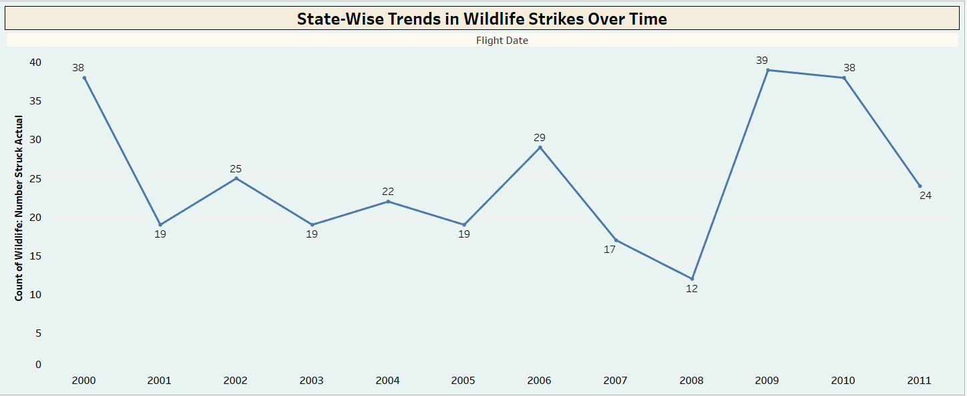
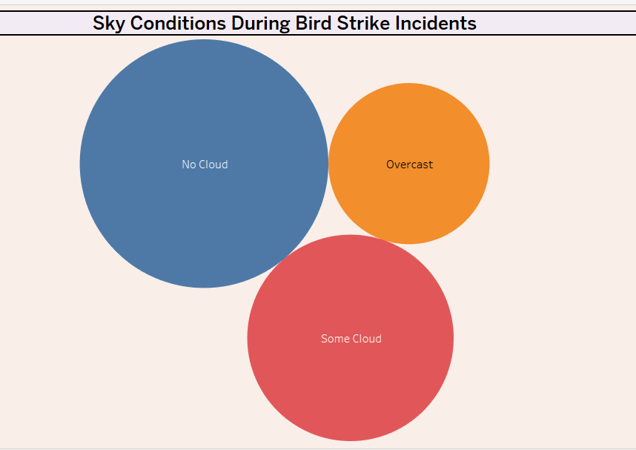
The strikes occurred in a state over the years
Sky Conditions During Hits
In Alabama, wild strikes occurred most frequently in 2010, followed by 2000, when compared to all other years.
The most bird strikes occurred under no cloud conditions, followed by some cloud and overcast conditions. This indicates that clear skies pose the highest risk for bird strikes.

Slide 7
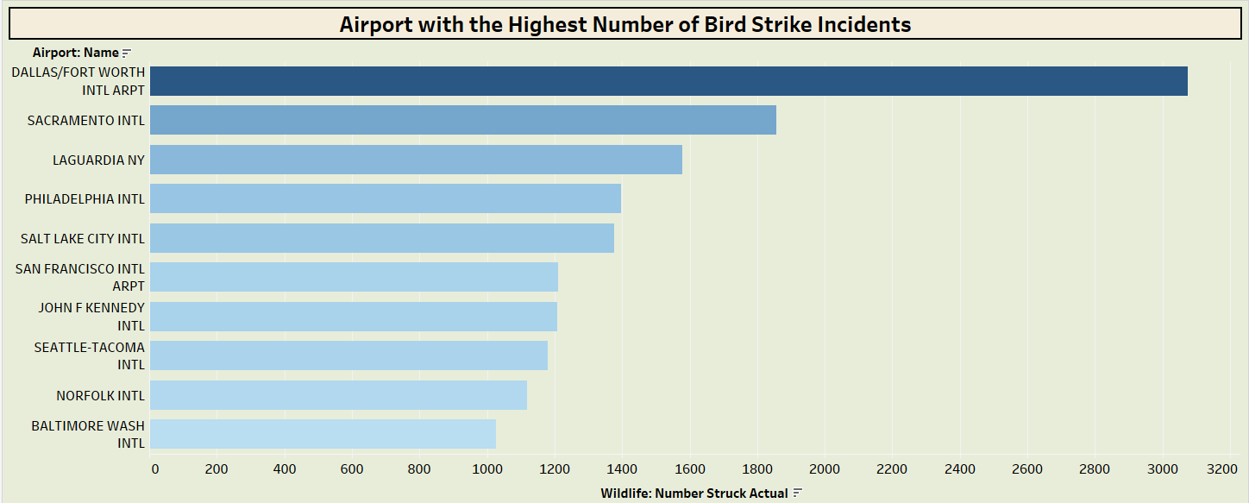
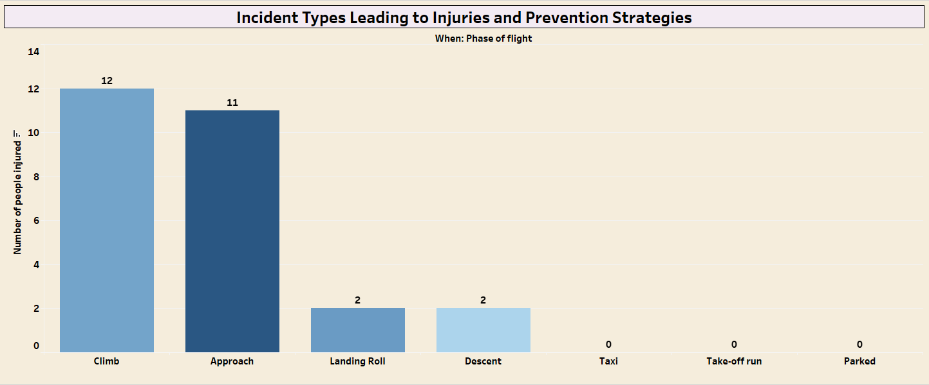
Airport with highest number of airstrikes
Types of incidents lead to injuries
Dallas/Fort Worth International Airport takes the highest number of airstrikes followed by Sacramento International Airport.
The majority of injuries occur during the climb and approach phases of flight and smaller number of injuries occur during landing roll, descent, and taxing.

Slide 8
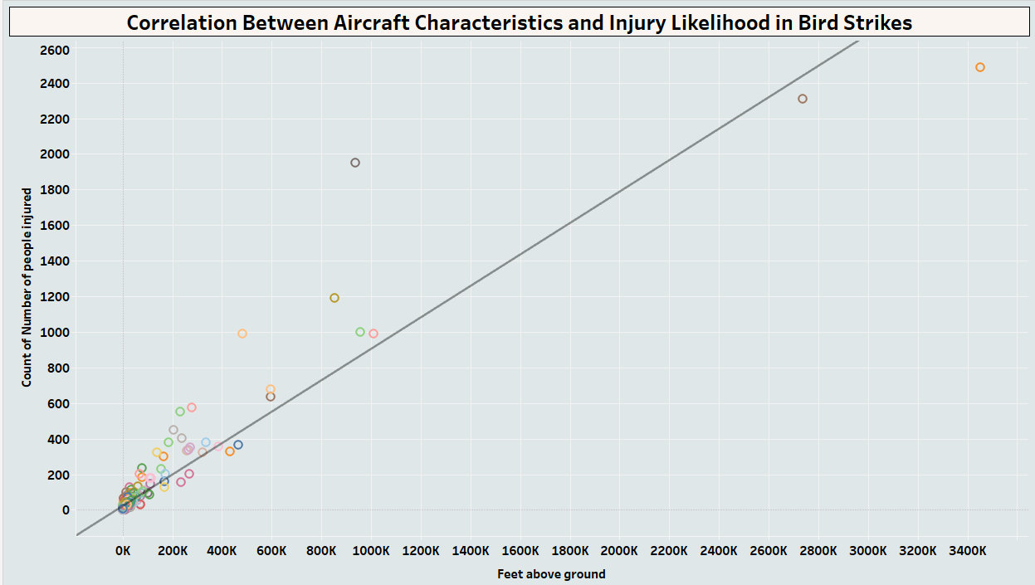
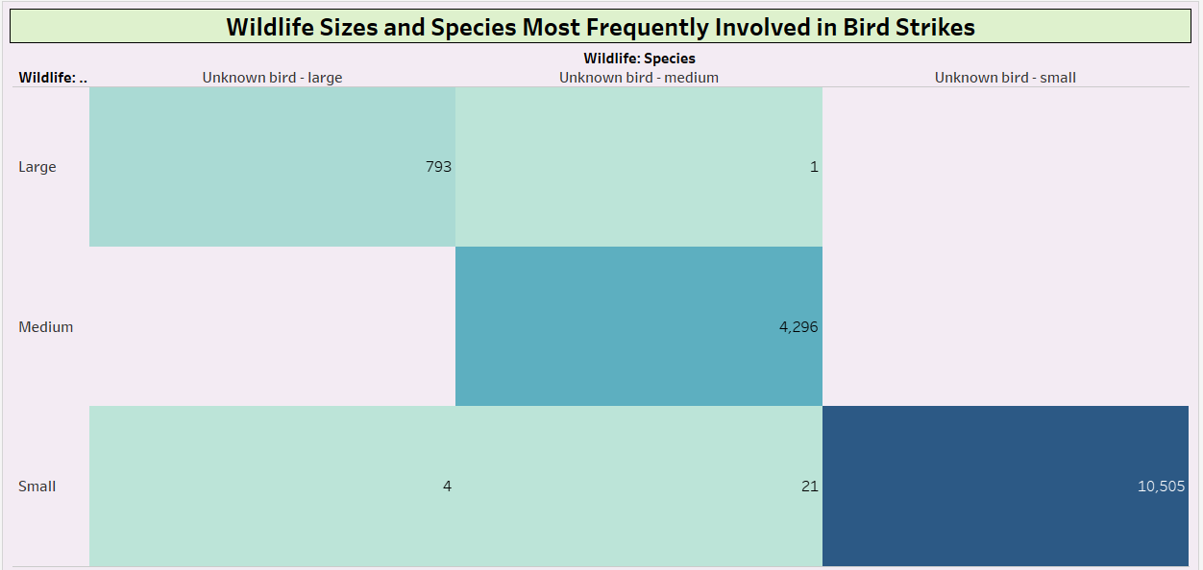
Correlation Between Aircraft Characteristics and No of Peoples Injured
sizes and species of wildlife are most frequently involved in bird strikes?
It shows the Positive Correlation between the Feet Above Ground and Count of Number of People Injured.
Small unknown birds are the most frequently involved in strikes, followed by medium-sized unknown birds.

Slide 9
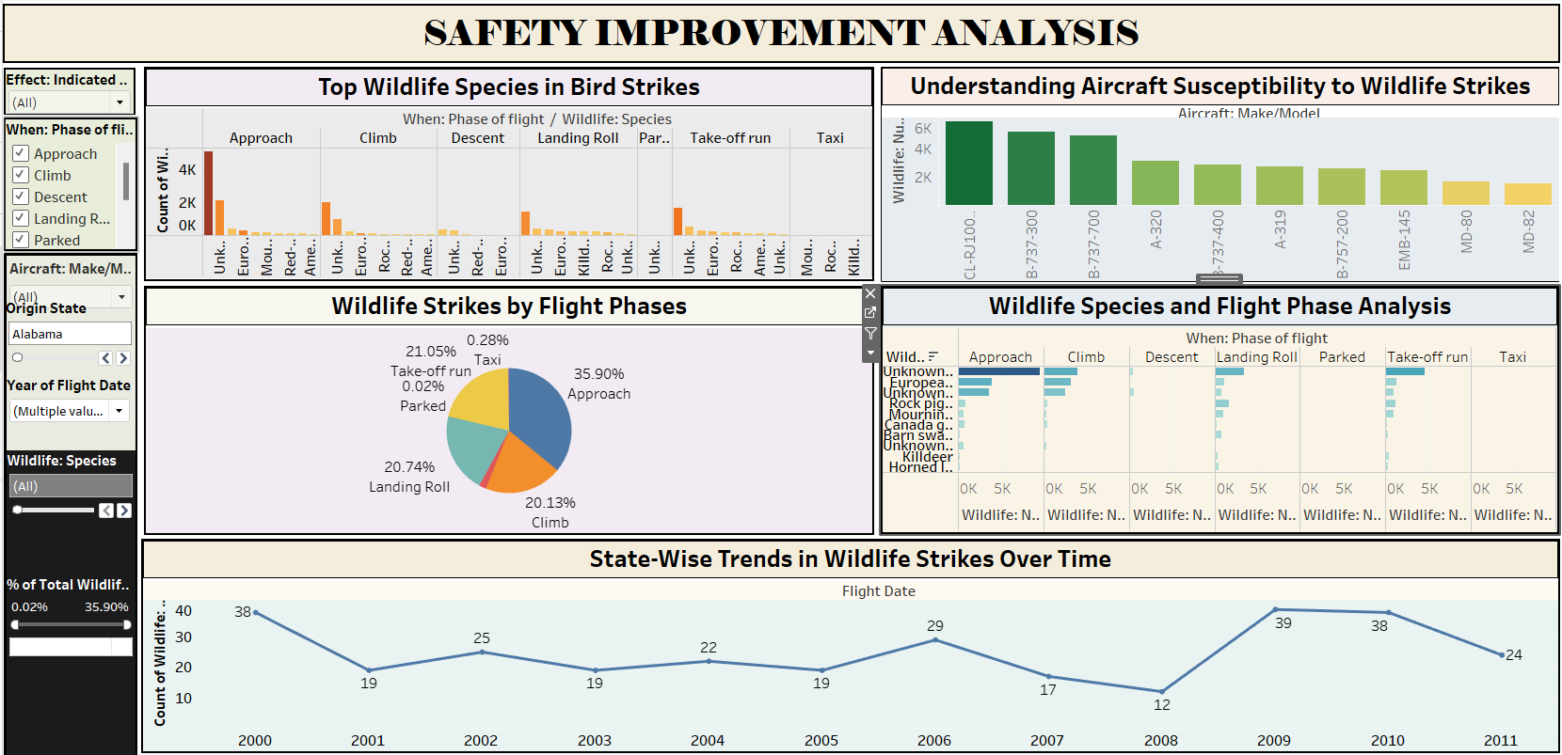

Slide 10
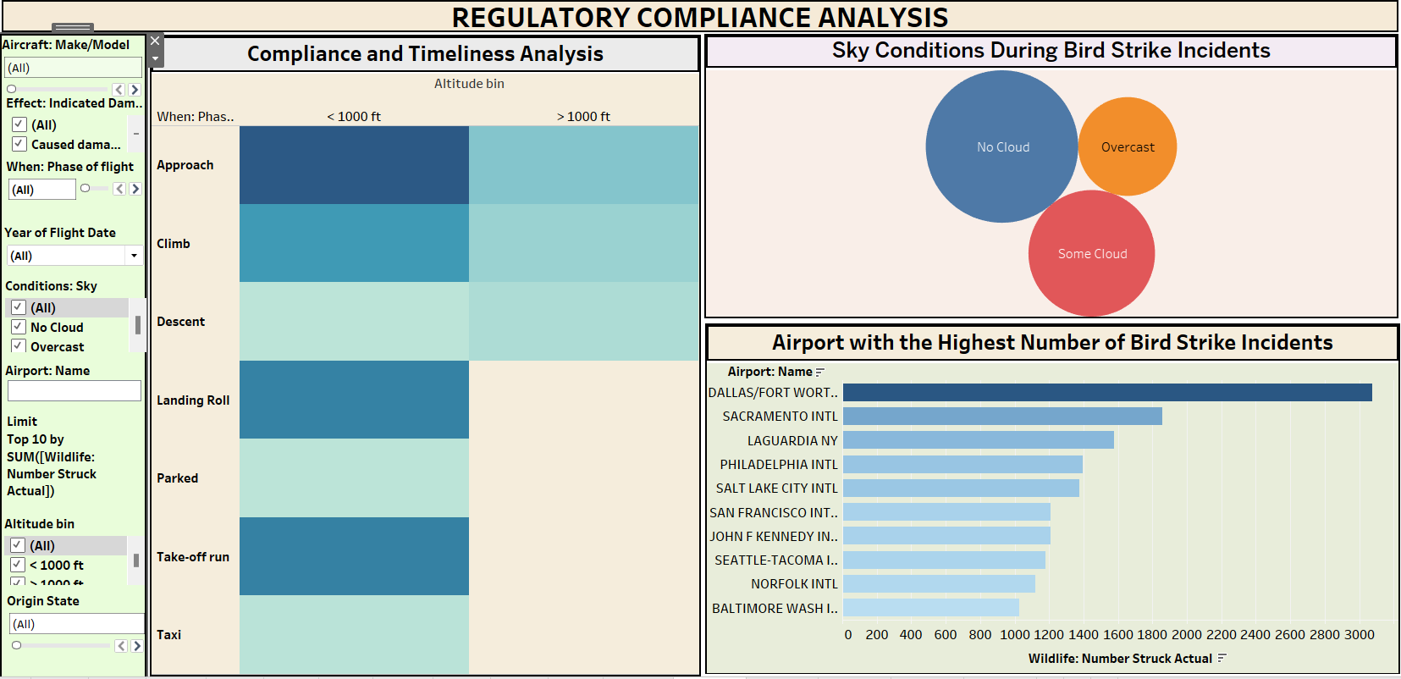

Slide 11
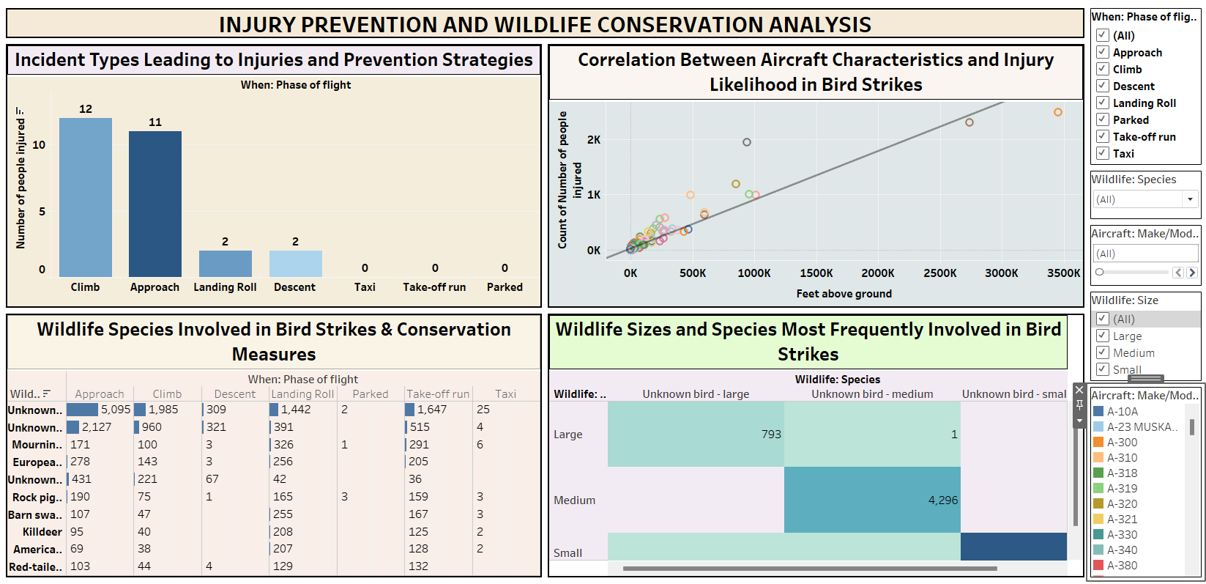

Slide 12
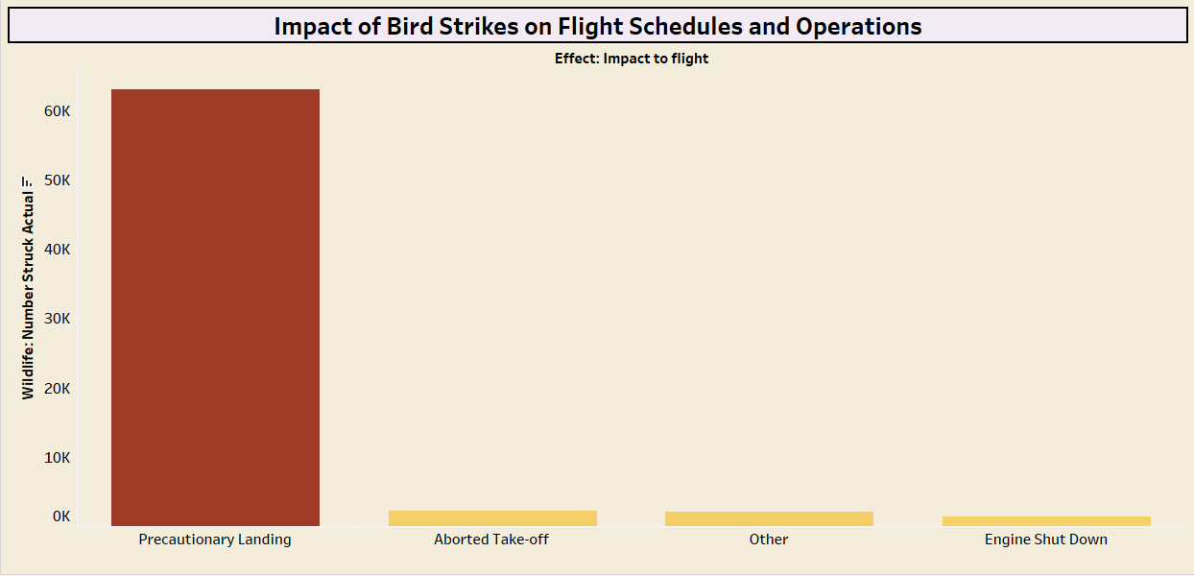
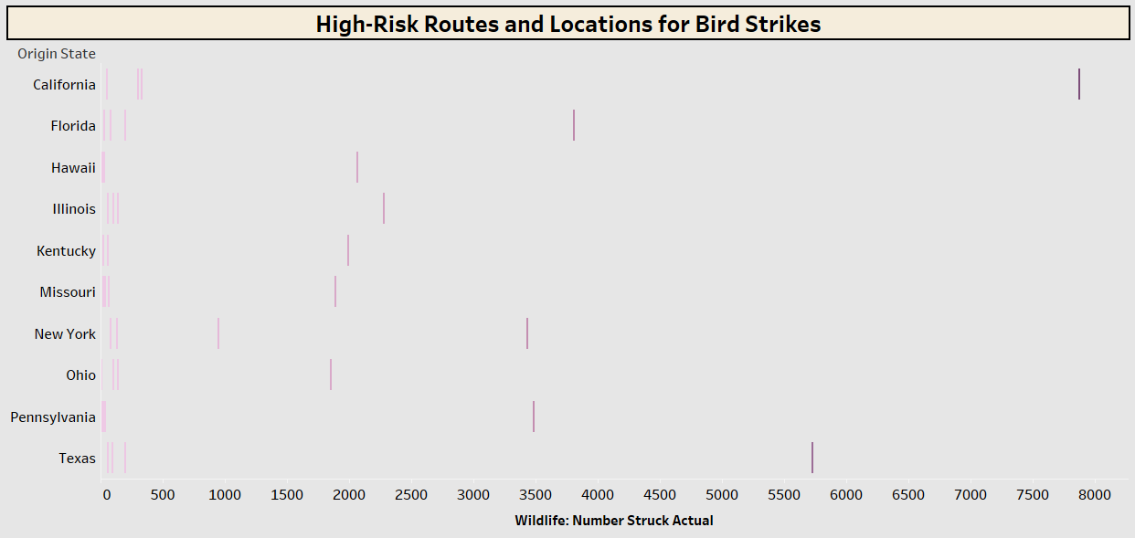
Bird Strike effect on Flight Schedules and Operations
Specific Routes or Locations along with the Bird Strikes
Bird strikes affect flight schedules and operations mostly in Precautionary Landing followed by aborted Take -off .
The state California state has chance of high risk routes for bird strikes.

Slide 13
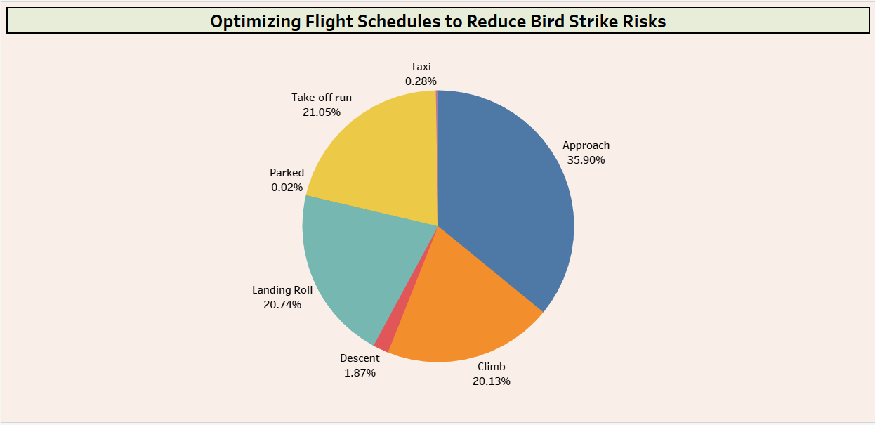
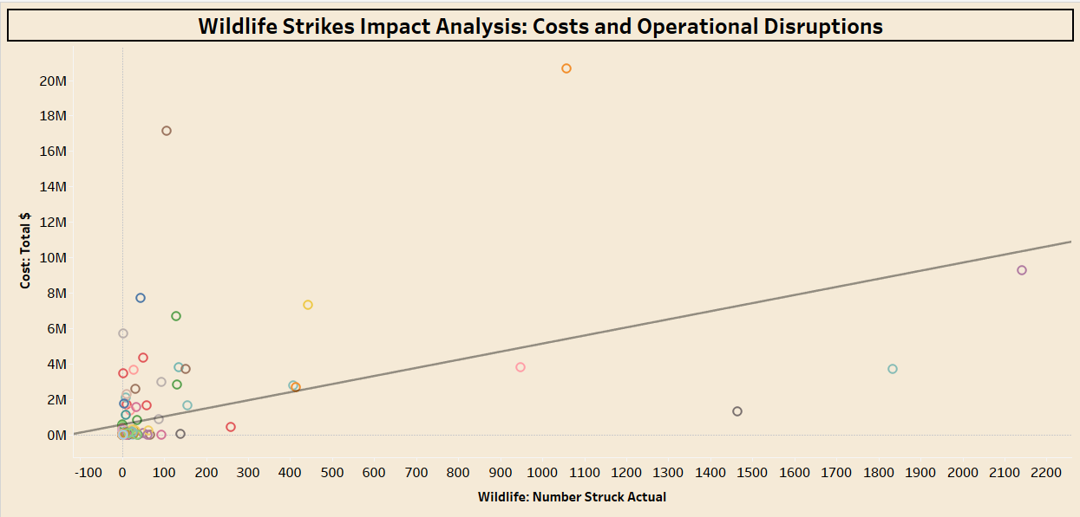
Optimizing Flight Schedules to Reduce Bird Strike Risks
Total cost associated with wildlife strikes
Approach phase has highest bird strikes. we need to reduce bird strikes in the approach phase of flight by constructing a fence near that region.
This shows that there is a positive correlation between the number of wildlife strikes and the total cost associated with them.

Slide 14
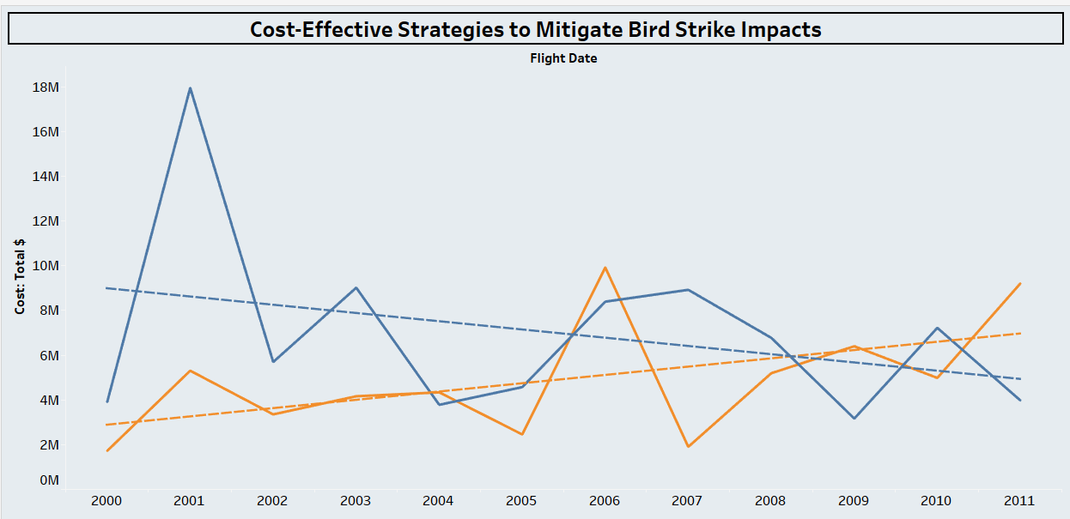
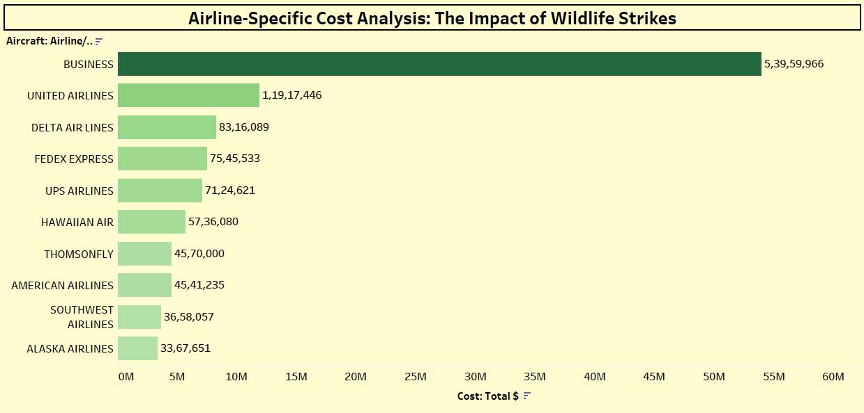
Cost-Effective Strategies to Mitigate Bird Strike Impacts
Cost Faced by Airlines
This shows a fluctuating trend in costs over time. the orange line shows a general downward trend, suggesting that implementing preventive measures can be cost-effective in reducing the overall financial impact of bird strikes.
Business aircraft incur the highest costs, followed by United Airlines and Delta Air Lines.

Slide 15
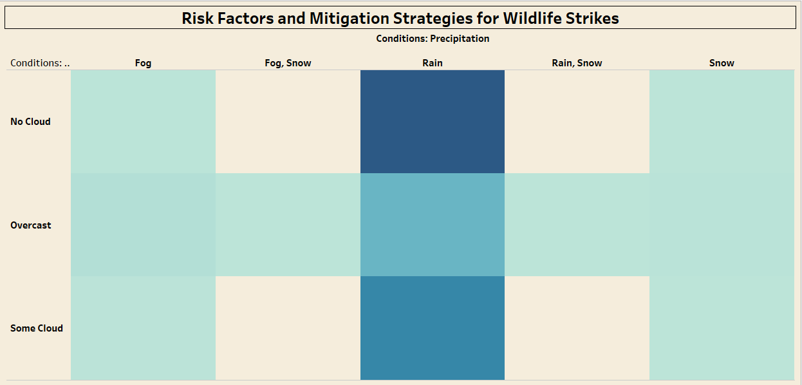
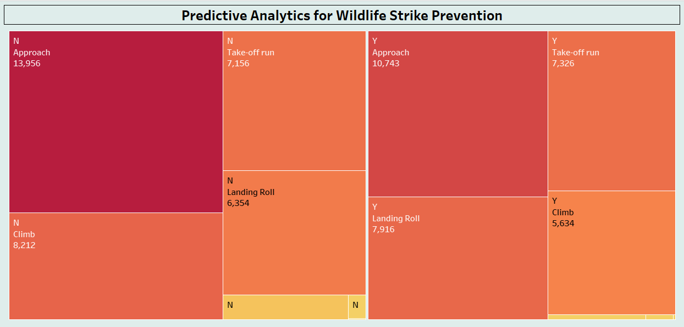
Risk Factor Contributing to Wildlife Strikes
Predictive Analytics for Wildlife Strike Prevention
The graph indicates that fog, snow, and rain increase the risk of wildlife strikes. Mitigation strategies include improved visibility systems, radar technology, and wildlife deterrent systems.
Yes, predictive models can be developed to identify and prevent potential wildlife strike incidents by analyzing historical data and identifying patterns in flight phases and locations.

Slide 16
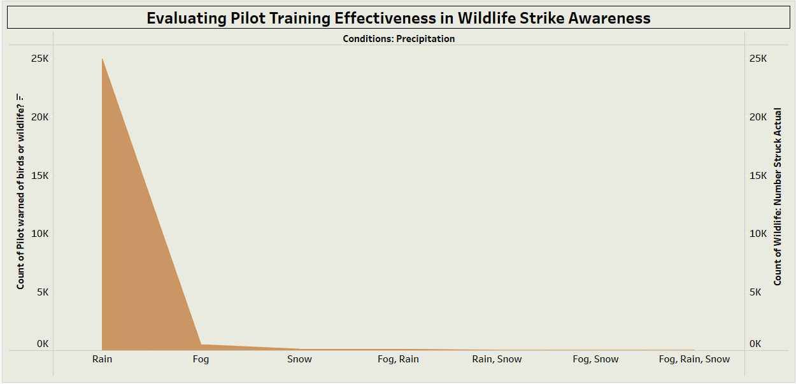
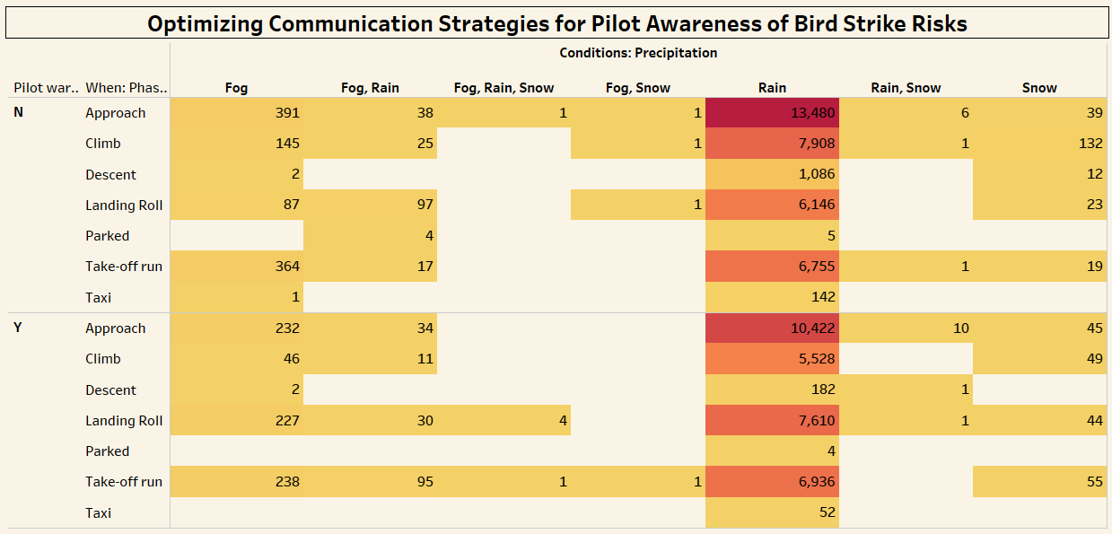
Effectiveness of current pilot training programs in raising awareness about wildlife strikes
Communication Strategies for Pilot Awareness of Bird Strike Risks
The graph suggests that current pilot training programs may not be fully effective in raising awareness about wildlife strikes, particularly in adverse weather conditions.
The graph highlights the need for effective communication strategies to enhance pilot awareness of bird strike risks, particularly during approach and landing roll phases in rainy conditions.

Slide 17
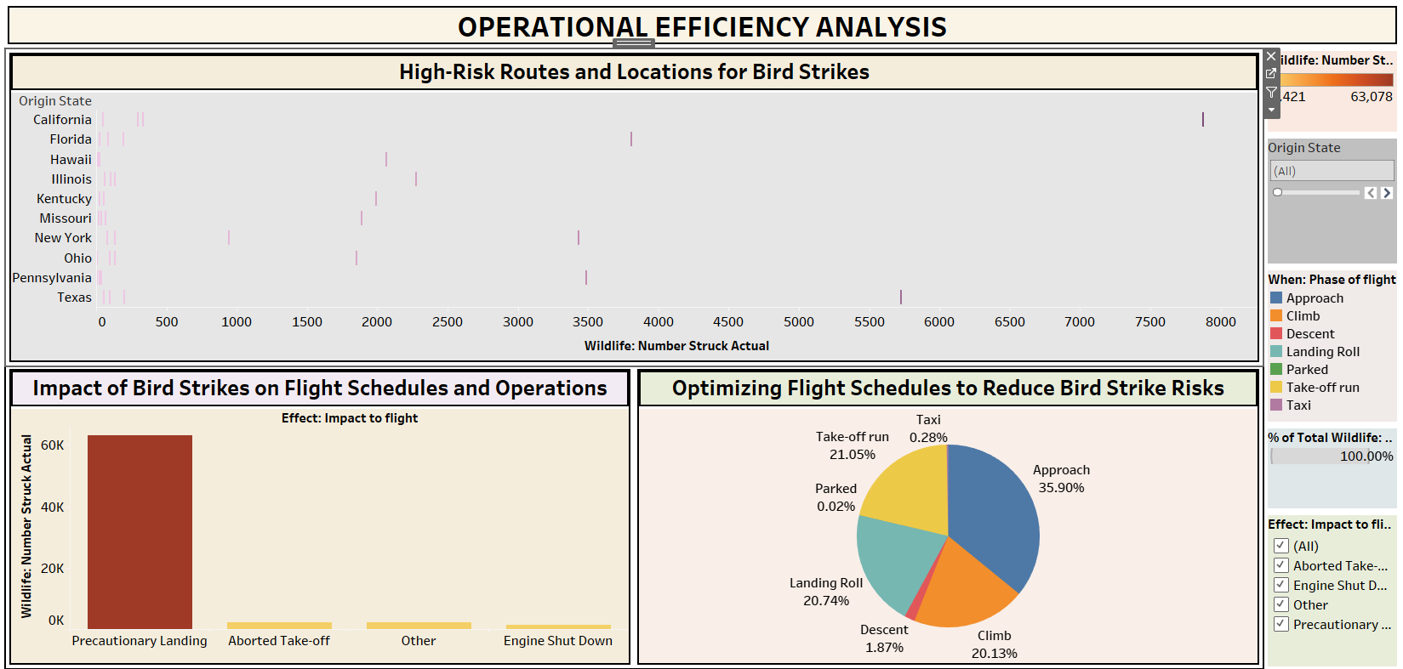

Slide 18
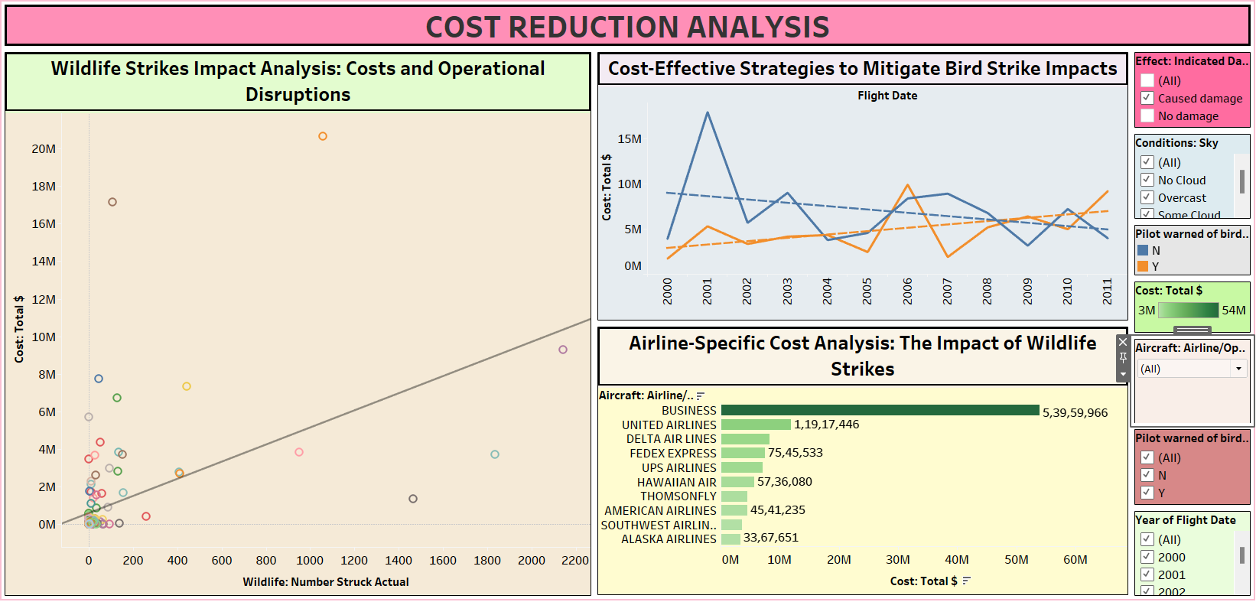

Slide 19
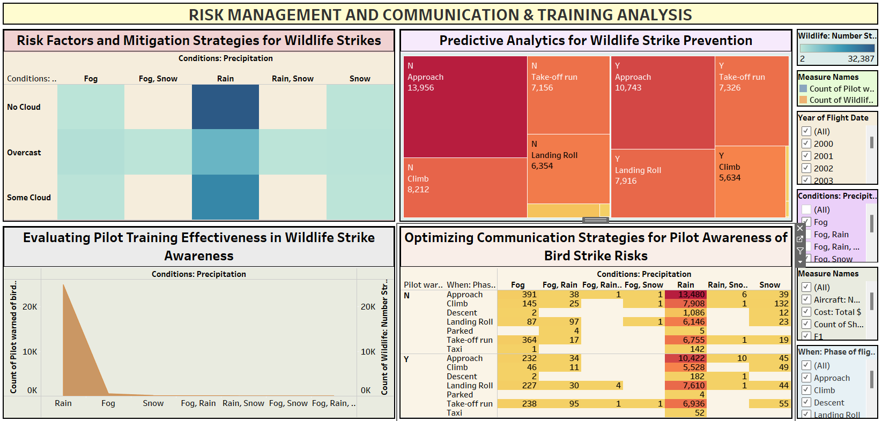

Slide 20
SUMMARY:
Unknown Bird-Medium is a wildlife species that gets struck in aircraft frequently.
Approach phase is when wildlife strikes are most likely to occur.
CL-RJ100/200 is an aircraft type with a high frequency of wildlife strikes.
Alabama had the most wildlife strikes in 2010 and 2000.
Climbing is an activity that increases the risk of wildlife strikes.

Slide 21
SUMMARY Cont:
Wildlife strikes happen more frequently in no cloud conditions compared to other sky conditions.
Dallas Airport has a higher frequency of wildlife strikes compared to other airports.
Precautionary landings are more prone to wildlife strikes compared to other flight phases.
Rain is a risk factor for wildlife strikes, especially compared to other precipitation conditions.
California and Texas have the highest number of wildlife strikes compared to other states.

Slide 22
CONCLUSION:
Weather Conditions Matter: Clear sky conditions increase the likelihood of wildlife strikes.
Airport Location is Crucial: Airports situated near water bodies or wildlife habitats are more susceptible to bird strikes.
Critical Flight Phases: Takeoff and landing phases, as well as precautionary landings, are particularly risky due to lower altitudes and slower speeds.
Specific Wildlife Species: The Unknown Bird-Medium is a significant contributor to aircraft strikes.
By addressing these factors, aviation authorities can implement effective mitigation strategies to reduce the risk of wildlife strikes and ensure the safety of air travel.

Slide 23
Thank You

